Slide 1










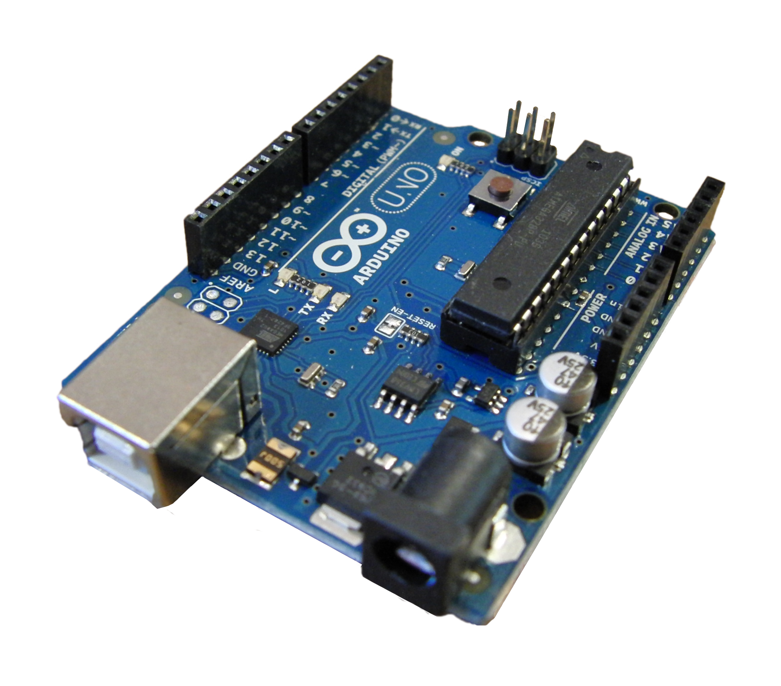


Presentation layer
Application layer
Data layer
Mobile app
Tram Tracking
System
Restful API
user
Admin System
Query
Tram
System
Web application
Tram tracking database
admin
tram
Address
Punch-in/punch out
driver

